Slide 1


Social Media Growth 2018-2022
Date | Twitter | Facebook | LinkedIn
Dec. 2019 | 2,758 | 2,511 | 1,092
Dec. 2020 | 3,527 | 2,532 | 1,106
Dec. 2021 | 4,091 | 2,535 | 1,107
Dec. 2022 | 4,550 | 2,584 | 1,155
Dec. 2023 | 4,979 | 2,642 | 1,219
Administered mainly by Business Office
Facebook has leveled off
Twitter continues to grow
LinkedIn is growing now the group is open
American Chemical Society Division of Polymer Chemistry

Slide 2
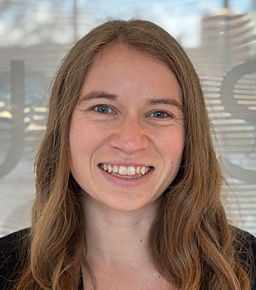
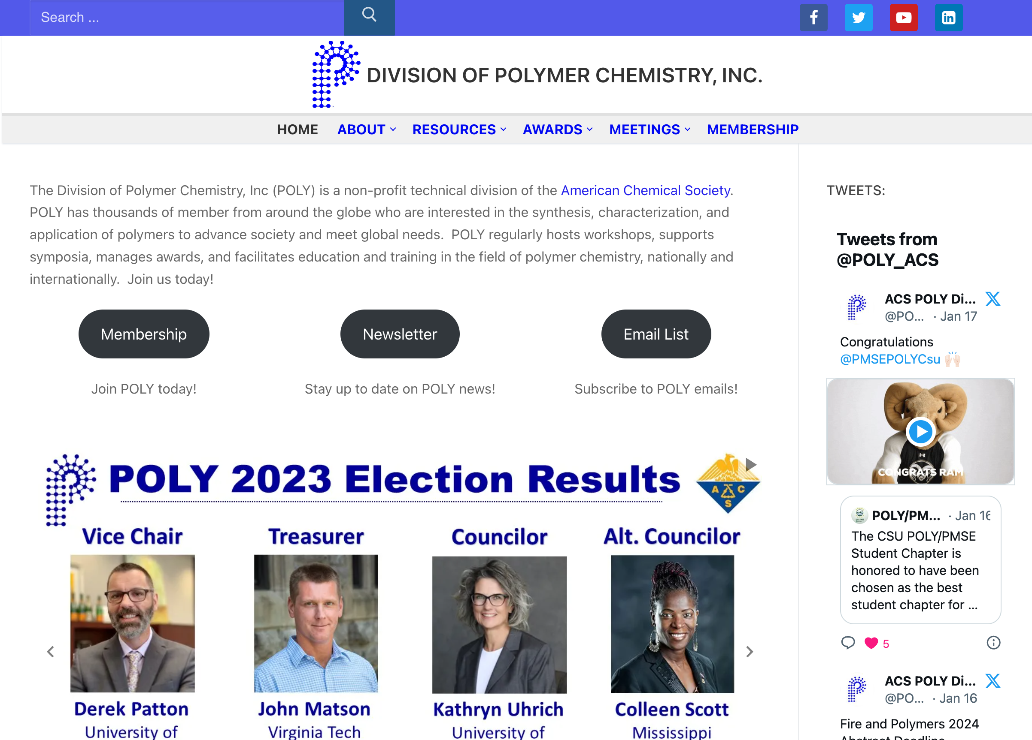
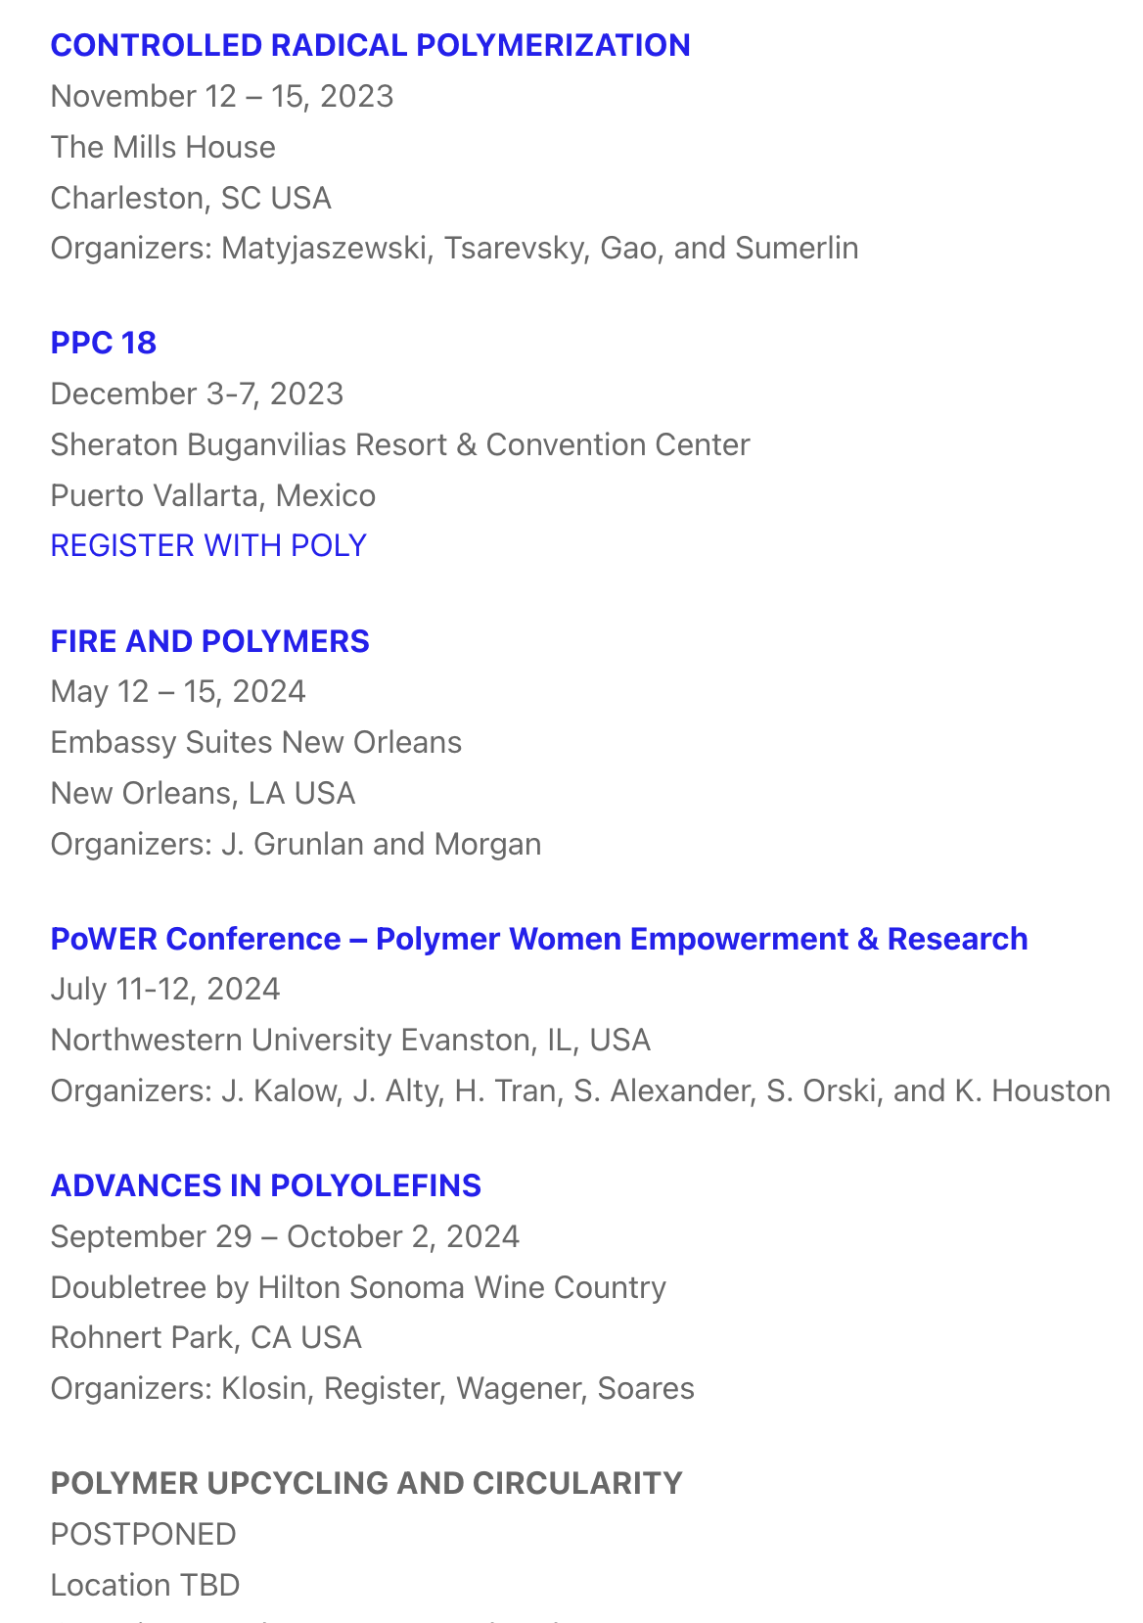

Quick Website Updates
Welcome Tayler Hebner! (Benoit Lab)
Main update: migration of workshop pages to polyacs.org
American Chemical Society Division of Polymer Chemistry

